Slide 1

An Introduction to Object Oriented Programming (OOP)!
An object is anything that you can see or touch - such as a book or a car.
Object ->
Every object has Attributes (data or properties – think variables) and
Behaviors (actions that the object can perform or have performed on it – think functions, in OOP, called methods).
Attributes
Behaviors
Manufacturer - Chevy
Model - Camaro
Color - Red
Accelerate
Brake
Steer
Tune up

Slide 2
An Introduction to Object Oriented Programming (OOP)!
A class is a pattern or blueprint for creating an object.
A class contains all the attributes and behaviors that describe the object.
When an object’s attributes and behaviors are combined into one package
(a class), it is called encapsulation.
The object you create is called an instance of that class.

Slide 3
An Introduction to Object Oriented Programming (OOP)!
Abstraction is when you hide internal details of an object.
ie. - the engine and spark plugs are “hidden” under the hood.
Exposed is when you allow users access to the attributes and
behaviors of an object.
ie. - the gas pedal, steering wheel

Slide 4
An Introduction to Object Oriented Programming (OOP)!
Inheritance refers to the fact that you can create one class
from another class.
The original class is called the base class.
The new class is called the derived class.

Slide 5
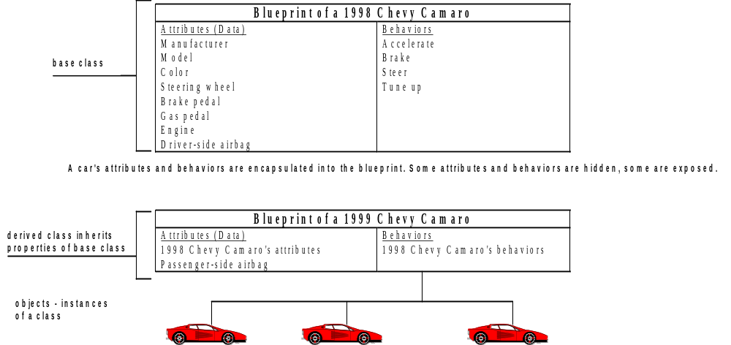
OOP Terms

Slide 6
An Introduction to Object Oriented Programming (OOP)!
Polymorphism is the ability to assign different meanings or a
different usage to something in different contexts.
This enables such entities as variables, functions, and objects
to have more than one form.

Slide 7
An Introduction to Object Oriented Programming (OOP)!
Example of polymorphism:
Specific to C++, the plus sign (+) is used a number of different ways.
1. To add to objects together, m = m + 1
2. As a logical “and”, if (6 > target) + (FICA < 10.76)
3. As a concatenator, msg = msg1 + msg2 + msg3

Slide 8
A Visual C++ Example
include <iostream.h>
#include<conio.h>
class Driver
{
private:
int idNum;
char lastName[15];
unsigned isMale:1;
unsigned isOver25:1;
public:
Driver ( int id, char name[], int gender, int older );
void showDriver();
};
Driver::Driver ( int id, char name[], int gender, int older )
{
idNum = id;
strcpy ( lastName, name);
isMale = gender;
isOver25 = older;
}

Slide 9
A Visual C++ Example - cont.
void Driver::showDriver()
{
cout << "ID #” << idNum << " Name: " << lastName << " Gender: ";
if (isMale==0)
cout << "Female ";
else
cout << "Male ";
if ( isOver25 == 0 )
cout << "Not over 25";
else
cout << "Over 25";
cout << endl;
}
void main()
{
Driver firstDriver ( 222, "Wallace", 0, 0 ), secondDriver ( 333, "Parker", 0, 1 ),
thirdDriver ( 444, "Larson”, 1, 0 ), fourthDriver ( 555, "Hernandez", 1, 1 );
firstDriver.showDriver();
secondDriver.showDriver();
thirdDriver.showDriver();
fourthDriver.showDriver();
getch();
}

